Slide 1
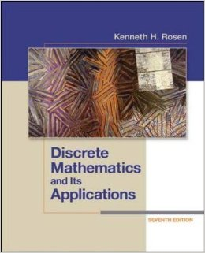
Course Details
MATH 1019
Discrete Mathematics for Computer Science
Rosen, 7ce
Discrete Mathematics & Its Applications
Fall 2016
Notes:
LSCs – Text image – go to (location for files where most are available, occasionally you may need to improvise or Google the image)
Update:
Course Name/Section
Author and Edition/Title

Slide 2
Purchase Options
Option 1:
Go All-Digital with Connect
Option 2:
Loose Leaf Print Text
Connect includes everything you need for this course, including the eBook.
Where to buy Connect:
Bookstore $99
The loose leaf print text, packaged with Connect, is available in the Bookstore.
Bookstore $218.90
Notes:
Note LSCs be aware of whether there are used books in the bookstore and what the cost is. However, we have removed used-books from the slide as we are not promoting them. Also – there are no used books for Front List titles.

Slide 3
Get Started in 4 Easy Steps
Go the Section Web Address below and click Register Now.
http://connect.mheducation.com/class/j-gryz-fall-2016
Enter your email address.
Enter your access code, or select “Buy Online.” You may also “Start Courtesy Access” if you don’t have an access code.
Complete the registration form and click Submit.
Notes:
Note- LSCs please change the Section Web Address that is required for the Professor’s Course in this slide

Slide 4
Registration
Go to the Section Web Address provided by your Instructor
Check the class details, and click Register Now
Notes:
LSCs – keep in case not able to demonstrate within Connect

Slide 5
Registration
Select one of the following options:
1. Enter in Registration Code
2. Buy Online directly from McGraw-Hill
3. Start your 14-day Courtesy Access
Notes:
LSCs – keep in case not able to demonstrate within Connect

Slide 6
Accessibility
McGraw-Hill Education strives to make content available that meets Canadian accessibility standards.
Contact your school’s Accessibility Office directly if you require accessible content for this course. They will work directly with McGraw-Hill to ensure that you receive the appropriate course materials.

Slide 7
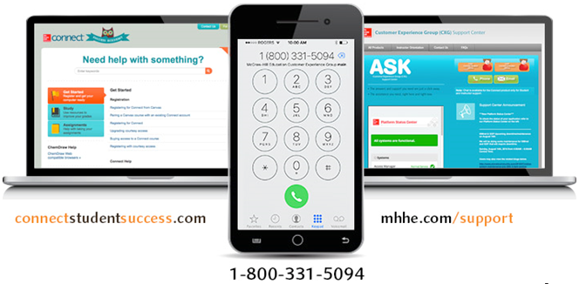
Canadian Support

Slide 8
Get a $20 McGraw-Hill Gift-Certificate
Qualifying Products
Purchase your McGraw-Hill Education course materials* before October 1, 2016.
As a Thank You, McGraw-Hill Education will email you a $20 eStore Gift- Certificate.
Valid between October 1, 2016 – December 31, 2017
For more details on how you can claim your eStore gift-certificate visit:
offers.mheducation.ca/20-estore-gift
*new course materials from any vendor
Connect
Connect & Print
Print Textbook
PDF eBook

Slide 9
Win a $5,000 Scholarship or
1 of 3 ASUS ZenBook™ Flip UX360 Devices!
To enter follow these steps:
Purchase any digital course materials such as Connect, Connect & Print Combo or PDF eBook.
Go to www.digitalcoursematerials.com and complete the entry form
Upload your receipt
Click Submit
Draw Date - Tuesday, October 4, 2016
NO PURCHASE NECESSARY. Only open to residents of Canada (excluding Quebec) who are 17 years of age or older and who were enrolled at a post-secondary institution in Canada before August 15, 2016. Entry must be received via online submission (with qualifying purchase between August 29, 2016 at 12:00:01 a.m. ET and September 23, 2016 at 11:59:59 p.m. ET) or no purchase necessary mail-in request before September 30, 2016 at 11:59:59 p.m. Full contest rules available at www.digitalcoursematerials.com/contestrules.

